Slide 1
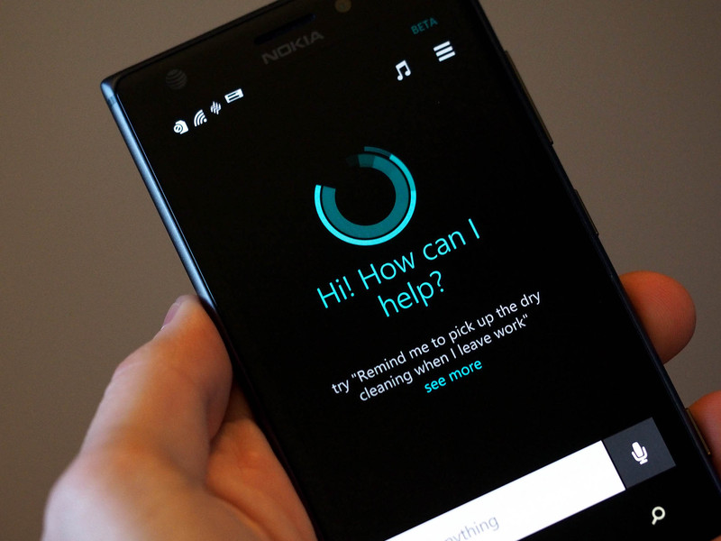
Cortana
Integrando nuestra aplicación Windows Phone con Cortana
CartujaDotNet

Slide 2


Javier Suárez Ruiz
Microsoft MVP Windows Platform Development
Blog: http://geeks.ms/blogs/jsuarez
Email: javiersuarezruiz@hotmail.com
Twitter: @jsuarezruiz

Slide 3


Agenda
Hola, soy Cortana.
¿Que puede hacer?
¿Cómo integro mi App con Cortana?
Consejos para una integración perfecta
Preguntas y respuestas

Slide 4
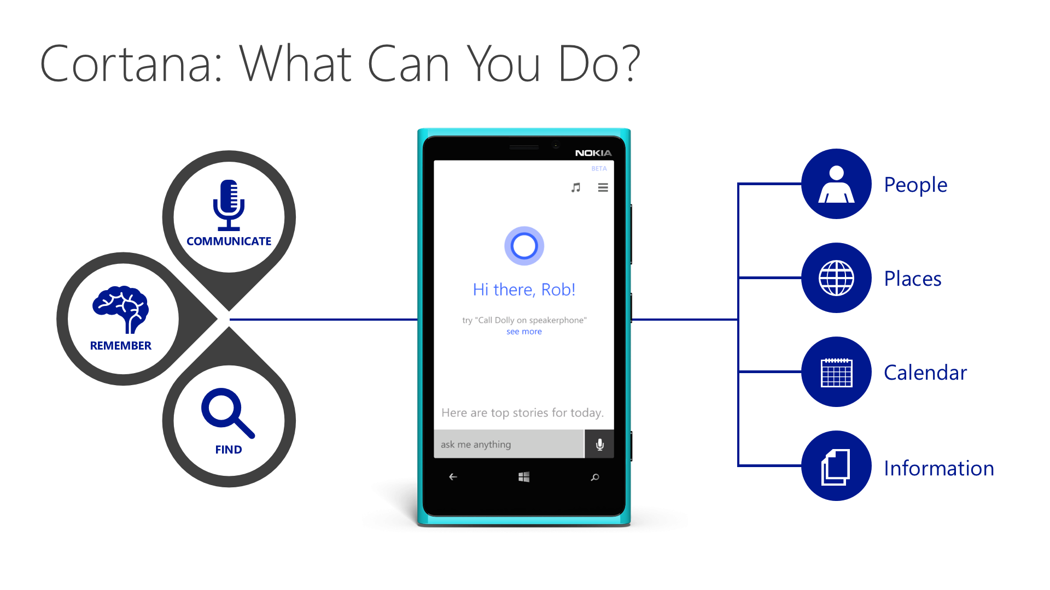
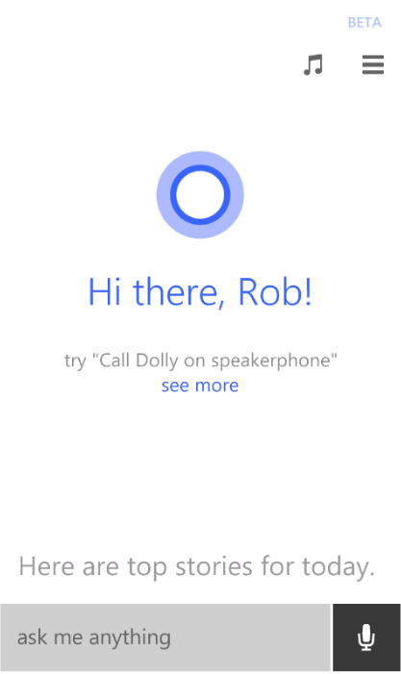
Cortana: ¿Que puede hacer?
Personas
COMMUNICATE
Lugares
REMEMBER
Calendario
FIND
Información

Slide 5

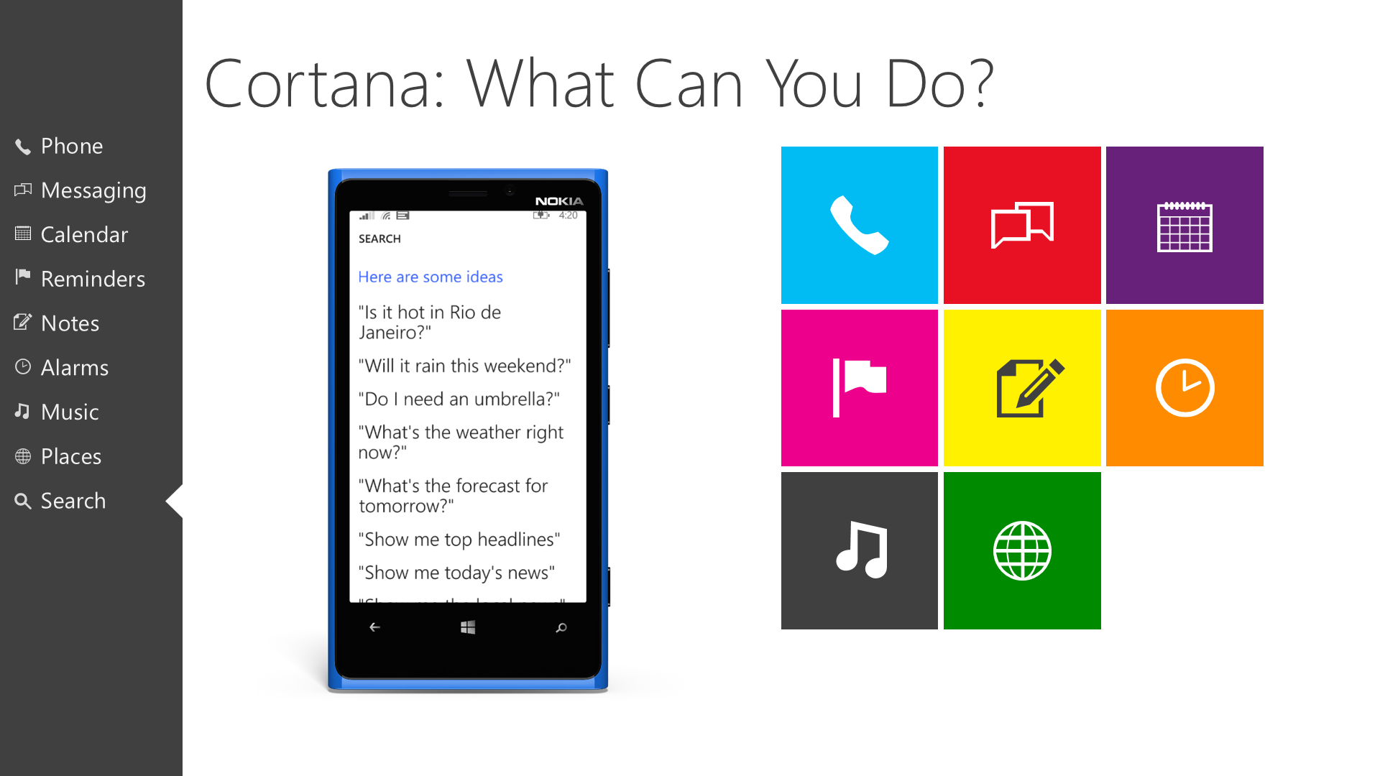








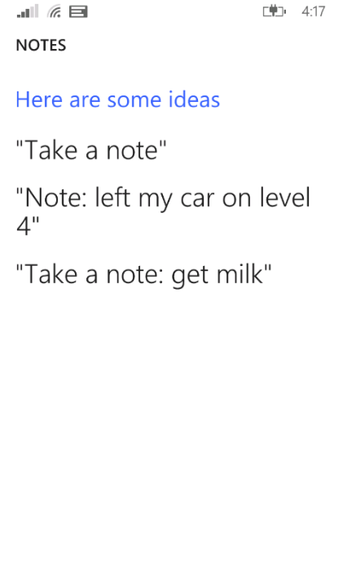
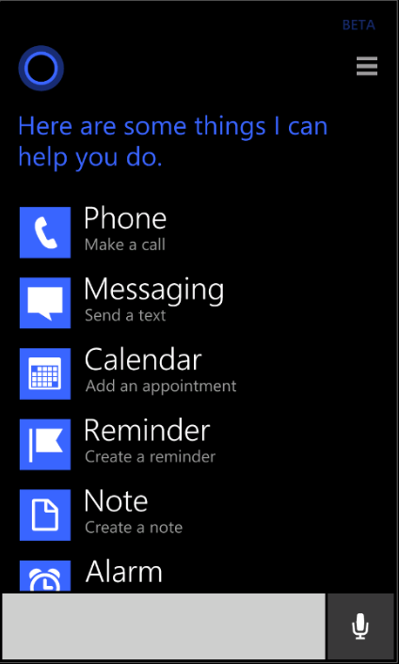
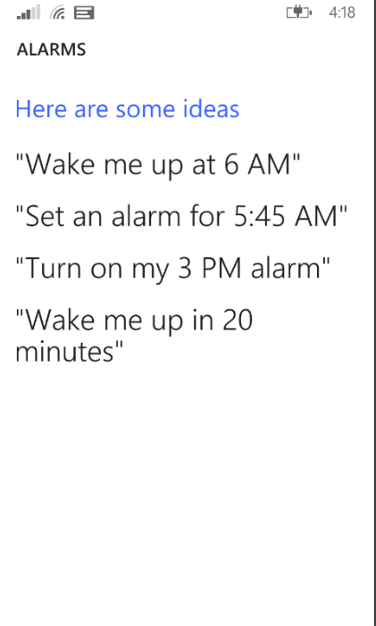
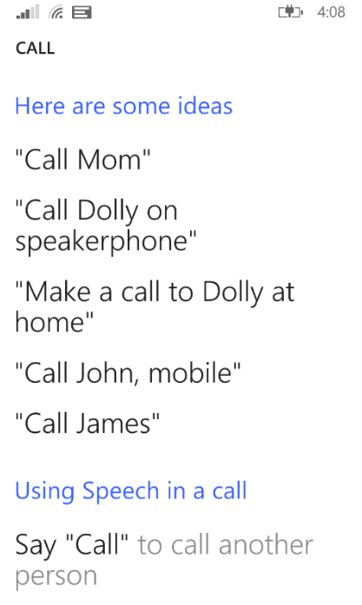
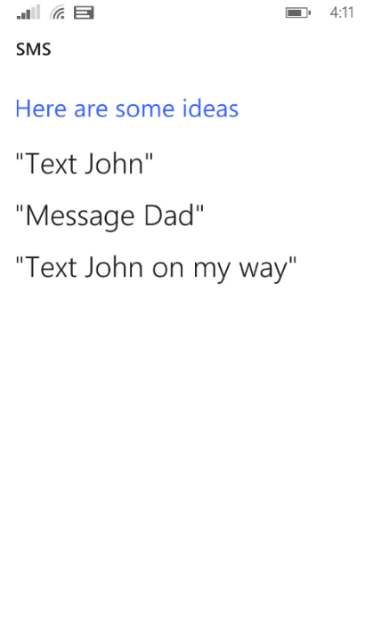
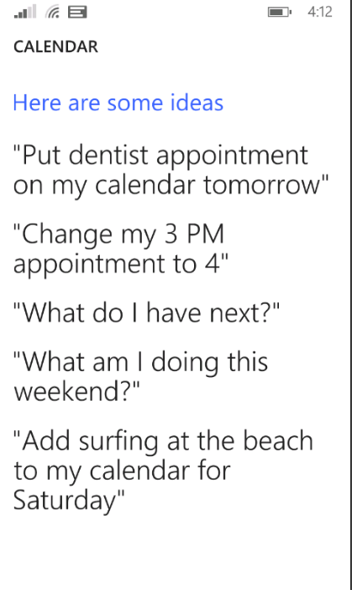
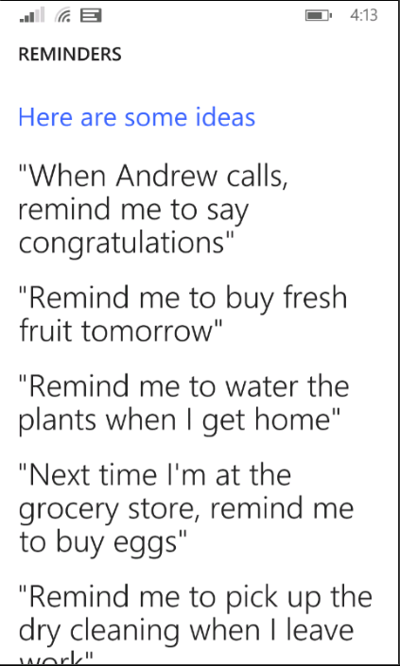
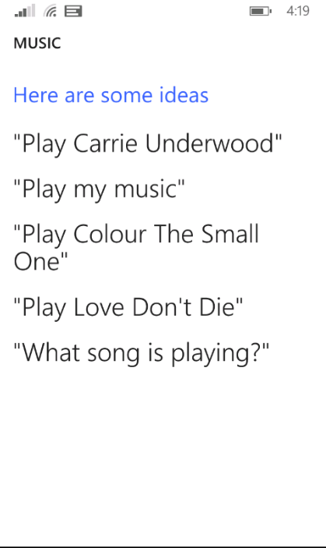
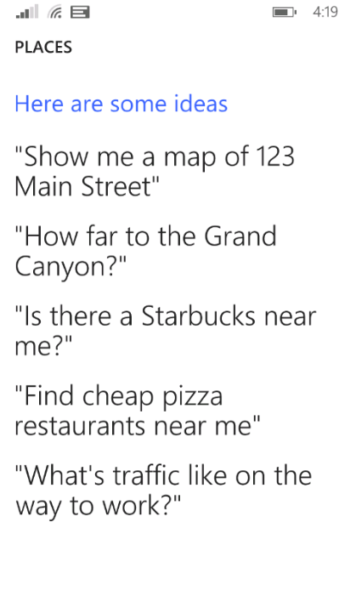
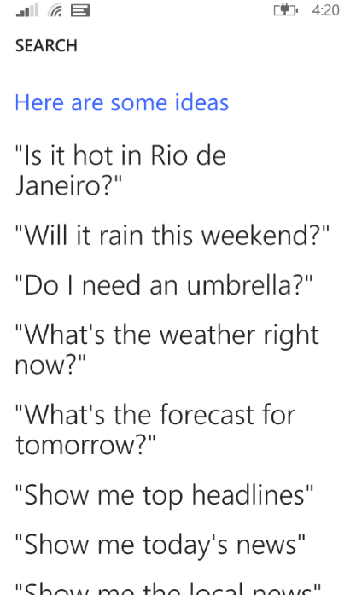
Cortana: What Can You Do?
Cortana: What Can You Do?
Your App goes here
Phone
Messaging
Calendar
Reminders
Notes
Alarms
Music
Places
Search

Slide 6
Demo 1
Uso de Cortana con Apps del sistema

Slide 7
Cortana lets you interact on your terms.
Speech recognition
Text input
You get to decide.
Natural language
Keywords
Built-in features
Your apps

Slide 8
Integrate with Cortana in 3 Easy Steps:
Create Voice Command Definition(s)
Register VCD XML on App Startup
Handle Voice Command Activation

Slide 9

Create Voice Command Definition(s)
<?xml version="1.0" encoding="utf-8"?>
<VoiceCommands xmlns="http://schemas.microsoft.com/voicecommands/1.1">
<CommandSet xml:lang="en-us" Name="englishCommands">
<CommandPrefix>MSDN</CommandPrefix>
<Example>How do I add Voice Commands to my application</Example>
<Command Name="FindText">
<Example>Find Install Voice Command Sets</Example>
<ListenFor>Search</ListenFor>
<ListenFor>Search for {dictatedSearchTerms}</ListenFor>
<ListenFor>Find</ListenFor>
<ListenFor>Find {dictatedSearchTerms}</ListenFor>
<Feedback>Search on MSDN</Feedback>
<Navigate Target="MainPage.xaml" />
</Command>
<Command Name="nlpCommand">
<Example>How do I add Voice Commands to my application</Example>
<ListenFor>{dictatedVoiceCommandText}</ListenFor>
<Feedback>Starting MSDN...</Feedback>
<Navigate Target="MainPage.xaml" />
</Command>
<PhraseTopic Label="dictatedVoiceCommandText" Scenario="Dictation">
<Subject>MSDN</Subject>
</PhraseTopic>
<PhraseTopic Label="dictatedSearchTerms" Scenario="Search">
<Subject>MSDN</Subject>
</PhraseTopic>
</CommandSet>
</VoiceCommands>
Step 1
Step 2
Step 3

Slide 10
Create Voice Command Definition(s)
<?xml version="1.0" encoding="utf-8"?>
<VoiceCommands xmlns="http://schemas.microsoft.com/voicecommands/1.1">
<CommandSet xml:lang="en-us" Name="englishCommands">
<CommandPrefix>MSDN</CommandPrefix>
<Example>How do I add Voice Commands to my application</Example>
<Command Name="FindText">
<Example>Find Install Voice Command Sets</Example>
<ListenFor>Search</ListenFor>
<ListenFor>Search for {dictatedSearchTerms}</ListenFor>
<ListenFor>Find</ListenFor>
<ListenFor>Find {dictatedSearchTerms}</ListenFor>
<Feedback>Search on MSDN</Feedback>
<Navigate Target="MainPage.xaml" />
</Command>
<Command Name="nlpCommand">
<Example>How do I add Voice Commands to my application</Example>
<ListenFor>{dictatedVoiceCommandText}</ListenFor>
<Feedback>Starting MSDN...</Feedback>
<Navigate Target="MainPage.xaml" />
</Command>
<PhraseTopic Label="dictatedVoiceCommandText" Scenario="Dictation">
<Subject>MSDN</Subject>
</PhraseTopic>
<PhraseTopic Label="dictatedSearchTerms" Scenario="Search">
<Subject>MSDN</Subject>
</PhraseTopic>
</CommandSet>
</VoiceCommands>
Step 1
<CommandPrefix>MSDN</CommandPrefix>
Command Prefix
Your Application’s name, or short form of same
Users can use either to address your application
Step 2
Step 3

Slide 11
Create Voice Command Definition(s)
<?xml version="1.0" encoding="utf-8"?>
<VoiceCommands xmlns="http://schemas.microsoft.com/voicecommands/1.1">
<CommandSet xml:lang="en-us" Name="englishCommands">
<CommandPrefix>MSDN</CommandPrefix>
<Example>How do I add Voice Commands to my application</Example>
<Command Name="FindText">
<Example>Find Install Voice Command Sets</Example>
<ListenFor>Search</ListenFor>
<ListenFor>Search for {dictatedSearchTerms}</ListenFor>
<ListenFor>Find</ListenFor>
<ListenFor>Find {dictatedSearchTerms}</ListenFor>
<Feedback>Search on MSDN</Feedback>
<Navigate Target="MainPage.xaml" />
</Command>
<Command Name="nlpCommand">
<Example>How do I add Voice Commands to my application</Example>
<ListenFor>{dictatedVoiceCommandText}</ListenFor>
<Feedback>Starting MSDN...</Feedback>
<Navigate Target="MainPage.xaml" />
</Command>
<PhraseTopic Label="dictatedVoiceCommandText" Scenario="Dictation">
<Subject>MSDN</Subject>
</PhraseTopic>
<PhraseTopic Label="dictatedSearchTerms" Scenario="Search">
<Subject>MSDN</Subject>
</PhraseTopic>
</CommandSet>
</VoiceCommands>
Step 1
<Example>How do I add Voice Commands to my application</Example>
Example
Top level example of what a user can say
“Advertised” in Cortana’s “What can I do?” UX
Step 2
Step 3

Slide 12
Create Voice Command Definition(s)
<Command Name="FindText">
<Example>Find Install Voice Command Sets</Example>
<ListenFor>Search</ListenFor>
<ListenFor>Search for {dictatedSearchTerms}</ListenFor>
<ListenFor>Find</ListenFor>
<ListenFor>Find {dictatedSearchTerms}</ListenFor>
<Feedback>Search on MSDN</Feedback>
<Navigate Target="MainPage.xaml" />
</Command>
<Command Name="nlpCommand">
<Example>How do I add Voice Commands to my application</Example>
<ListenFor>{dictatedVoiceCommandText}</ListenFor>
<Feedback>Starting MSDN...</Feedback>
<Navigate Target="MainPage.xaml" />
</Command>
<?xml version="1.0" encoding="utf-8"?>
<VoiceCommands xmlns="http://schemas.microsoft.com/voicecommands/1.1">
<CommandSet xml:lang="en-us" Name="englishCommands">
<CommandPrefix>MSDN</CommandPrefix>
<Example>How do I add Voice Commands to my application</Example>
<Command Name="FindText">
<Example>Find Install Voice Command Sets</Example>
<ListenFor>Search</ListenFor>
<ListenFor>Search for {dictatedSearchTerms}</ListenFor>
<ListenFor>Find</ListenFor>
<ListenFor>Find {dictatedSearchTerms}</ListenFor>
<Feedback>Search on MSDN</Feedback>
<Navigate Target="MainPage.xaml" />
</Command>
<Command Name="nlpCommand">
<Example>How do I add Voice Commands to my application</Example>
<ListenFor>{dictatedVoiceCommandText}</ListenFor>
<Feedback>Starting MSDN...</Feedback>
<Navigate Target="MainPage.xaml" />
</Command>
<PhraseTopic Label="dictatedVoiceCommandText" Scenario="Dictation">
<Subject>MSDN</Subject>
</PhraseTopic>
<PhraseTopic Label="dictatedSearchTerms" Scenario="Search">
<Subject>MSDN</Subject>
</PhraseTopic>
</CommandSet>
</VoiceCommands>
Step 1
Step 2
Command
Logical unit of user “intent”
Contains …
… What the user says to Cortana
… What Cortana says in response
… What action Cortana will perform
Step 3

Slide 13
Create Voice Command Definition(s)
<?xml version="1.0" encoding="utf-8"?>
<VoiceCommands xmlns="http://schemas.microsoft.com/voicecommands/1.1">
<CommandSet xml:lang="en-us" Name="englishCommands">
<CommandPrefix>MSDN</CommandPrefix>
<Example>How do I add Voice Commands to my application</Example>
<Command Name="FindText">
<Example>Find Install Voice Command Sets</Example>
<ListenFor>Search</ListenFor>
<ListenFor>Search for {dictatedSearchTerms}</ListenFor>
<ListenFor>Find</ListenFor>
<ListenFor>Find {dictatedSearchTerms}</ListenFor>
<Feedback>Search on MSDN</Feedback>
<Navigate Target="MainPage.xaml" />
</Command>
<Command Name="nlpCommand">
<Example>How do I add Voice Commands to my application</Example>
<ListenFor>{dictatedVoiceCommandText}</ListenFor>
<Feedback>Starting MSDN...</Feedback>
<Navigate Target="MainPage.xaml" />
</Command>
<PhraseTopic Label="dictatedVoiceCommandText" Scenario="Dictation">
<Subject>MSDN</Subject>
</PhraseTopic>
<PhraseTopic Label="dictatedSearchTerms" Scenario="Search">
<Subject>MSDN</Subject>
</PhraseTopic>
</CommandSet>
</VoiceCommands>
Step 1
<Example>Find Install Voice Command Sets</Example>
Example
Level 2 example of what a user can say
“Advertised” in Cortana’s “What can I do” UX
Step 2
Step 3

Slide 14
Create Voice Command Definition(s)
<?xml version="1.0" encoding="utf-8"?>
<VoiceCommands xmlns="http://schemas.microsoft.com/voicecommands/1.1">
<CommandSet xml:lang="en-us" Name="englishCommands">
<CommandPrefix>MSDN</CommandPrefix>
<Example>How do I add Voice Commands to my application</Example>
<Command Name="FindText">
<Example>Find Install Voice Command Sets</Example>
<ListenFor>Search</ListenFor>
<ListenFor>Search for {dictatedSearchTerms}</ListenFor>
<ListenFor>Find</ListenFor>
<ListenFor>Find {dictatedSearchTerms}</ListenFor>
<Feedback>Search on MSDN</Feedback>
<Navigate Target="MainPage.xaml" />
</Command>
<Command Name="nlpCommand">
<Example>How do I add Voice Commands to my application</Example>
<ListenFor>{dictatedVoiceCommandText}</ListenFor>
<Feedback>Starting MSDN...</Feedback>
<Navigate Target="MainPage.xaml" />
</Command>
<PhraseTopic Label="dictatedVoiceCommandText" Scenario="Dictation">
<Subject>MSDN</Subject>
</PhraseTopic>
<PhraseTopic Label="dictatedSearchTerms" Scenario="Search">
<Subject>MSDN</Subject>
</PhraseTopic>
</CommandSet>
</VoiceCommands>
Step 1
<ListenFor>Search</ListenFor>
<ListenFor>Search for {dictatedSearchTerms}</ListenFor>
<ListenFor>Find</ListenFor>
<ListenFor>Find {dictatedSearchTerms}</ListenFor>
Listen for
One or more phrases
Phrases can contain “slot” references
Slots can be Phrase Lists, or Phrase Topics
Step 2
Step 3

Slide 15
Create Voice Command Definition(s)
<?xml version="1.0" encoding="utf-8"?>
<VoiceCommands xmlns="http://schemas.microsoft.com/voicecommands/1.1">
<CommandSet xml:lang="en-us" Name="englishCommands">
<CommandPrefix>MSDN</CommandPrefix>
<Example>How do I add Voice Commands to my application</Example>
<Command Name="FindText">
<Example>Find Install Voice Command Sets</Example>
<ListenFor>Search</ListenFor>
<ListenFor>Search for {dictatedSearchTerms}</ListenFor>
<ListenFor>Find</ListenFor>
<ListenFor>Find {dictatedSearchTerms}</ListenFor>
<Feedback>Search on MSDN</Feedback>
<Navigate Target="MainPage.xaml" />
</Command>
<Command Name="nlpCommand">
<Example>How do I add Voice Commands to my application</Example>
<ListenFor>{dictatedVoiceCommandText}</ListenFor>
<Feedback>Starting MSDN...</Feedback>
<Navigate Target="MainPage.xaml" />
</Command>
<PhraseTopic Label="dictatedVoiceCommandText" Scenario="Dictation">
<Subject>MSDN</Subject>
</PhraseTopic>
<PhraseTopic Label="dictatedSearchTerms" Scenario="Search">
<Subject>MSDN</Subject>
</PhraseTopic>
</CommandSet>
</VoiceCommands>
Step 1
<Feedback>Search on MSDN</Feedback>
Feedback
Visual/Auditory feedback when command has been recognized, before App is launched
Can also contain references to slots, e.g.: “Search on MSDN for {dictatedSearchTerms}”
Step 2
Step 3

Slide 16
Create Voice Command Definition(s)
<?xml version="1.0" encoding="utf-8"?>
<VoiceCommands xmlns="http://schemas.microsoft.com/voicecommands/1.1">
<CommandSet xml:lang="en-us" Name="englishCommands">
<CommandPrefix>MSDN</CommandPrefix>
<Example>How do I add Voice Commands to my application</Example>
<Command Name="FindText">
<Example>Find Install Voice Command Sets</Example>
<ListenFor>Search</ListenFor>
<ListenFor>Search for {dictatedSearchTerms}</ListenFor>
<ListenFor>Find</ListenFor>
<ListenFor>Find {dictatedSearchTerms}</ListenFor>
<Feedback>Search on MSDN</Feedback>
<Navigate Target="MainPage.xaml" />
</Command>
<Command Name="nlpCommand">
<Example>How do I add Voice Commands to my application</Example>
<ListenFor>{dictatedVoiceCommandText}</ListenFor>
<Feedback>Starting MSDN...</Feedback>
<Navigate Target="MainPage.xaml" />
</Command>
<PhraseTopic Label="dictatedVoiceCommandText" Scenario="Dictation">
<Subject>MSDN</Subject>
</PhraseTopic>
<PhraseTopic Label="dictatedSearchTerms" Scenario="Search">
<Subject>MSDN</Subject>
</PhraseTopic>
</CommandSet>
</VoiceCommands>
Step 1
<Navigate Target="MainPage.xaml" />
Navigate
Action to perform
Optional for non-Silverlight Apps
Step 2
Step 3

Slide 17
Create Voice Command Definition(s)
<?xml version="1.0" encoding="utf-8"?>
<VoiceCommands xmlns="http://schemas.microsoft.com/voicecommands/1.1">
<CommandSet xml:lang="en-us" Name="englishCommands">
<CommandPrefix>MSDN</CommandPrefix>
<Example>How do I add Voice Commands to my application</Example>
<Command Name="FindText">
<Example>Find Install Voice Command Sets</Example>
<ListenFor>Search</ListenFor>
<ListenFor>Search for {dictatedSearchTerms}</ListenFor>
<ListenFor>Find</ListenFor>
<ListenFor>Find {dictatedSearchTerms}</ListenFor>
<Feedback>Search on MSDN</Feedback>
<Navigate Target="MainPage.xaml" />
</Command>
<Command Name="nlpCommand">
<Example>How do I add Voice Commands to my application</Example>
<ListenFor>{dictatedVoiceCommandText}</ListenFor>
<Feedback>Starting MSDN...</Feedback>
<Navigate Target="MainPage.xaml" />
</Command>
<PhraseTopic Label="dictatedVoiceCommandText" Scenario="Dictation">
<Subject>MSDN</Subject>
</PhraseTopic>
<PhraseTopic Label="dictatedSearchTerms" Scenario="Search">
<Subject>MSDN</Subject>
</PhraseTopic>
</CommandSet>
</VoiceCommands>
<PhraseTopic Label="dictatedVoiceCommandText" Scenario="Dictation">
<Subject>MSDN</Subject>
</PhraseTopic>
<PhraseTopic Label="dictatedSearchTerms" Scenario="Search">
<Subject>MSDN</Subject>
</PhraseTopic>
Step 1
Phrase Topic
Similar to Phrase Lists from Windows Phone 8.0
Scenario hints to guide accuracy improvements
Recognized in cloud, not on device
Significantly increased speech recognition accuracy (35% reduction in errors)
Step 2
Step 3

Slide 18
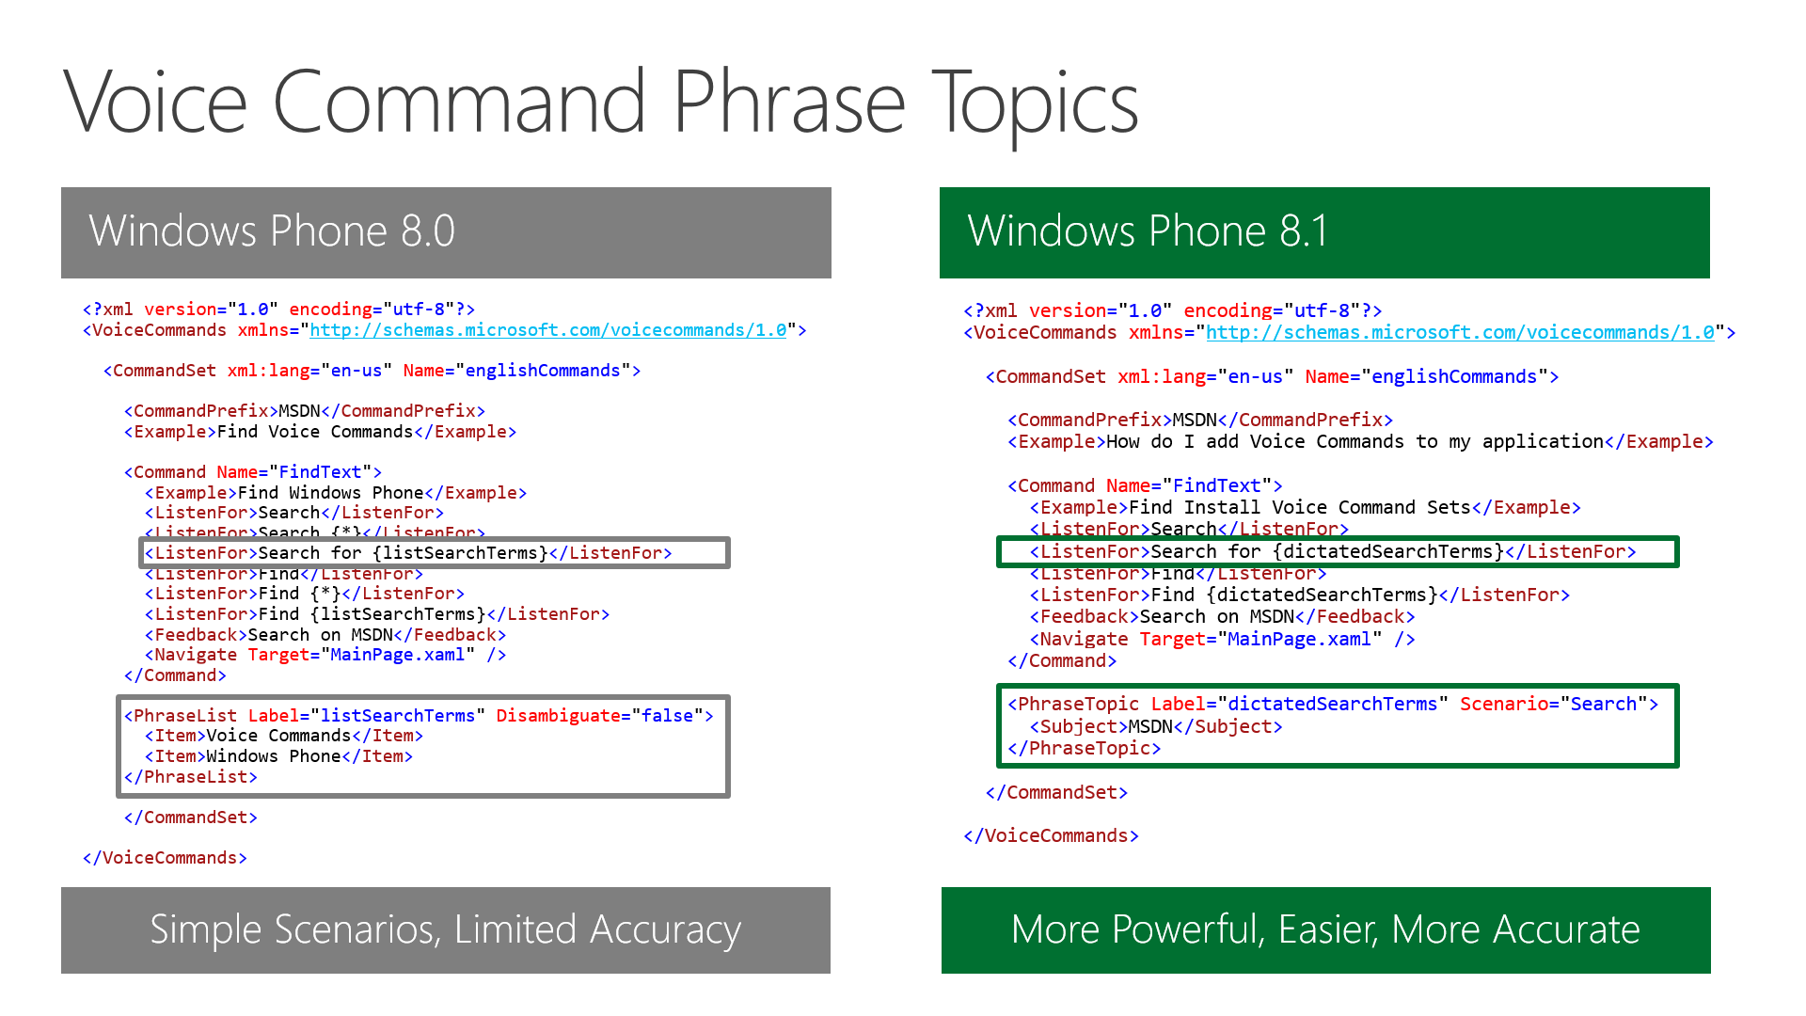
Voice Command Phrase Topics
Windows Phone 8.0
Windows Phone 8.1
<?xml version="1.0" encoding="utf-8"?>
<VoiceCommands xmlns="http://schemas.microsoft.com/voicecommands/1.0">
<CommandSet xml:lang="en-us" Name="englishCommands">
<CommandPrefix>MSDN</CommandPrefix>
<Example>Find Voice Commands</Example>
<Command Name="FindText">
<Example>Find Windows Phone</Example>
<ListenFor>Search</ListenFor>
<ListenFor>Search {*}</ListenFor>
<ListenFor>Search for {listSearchTerms}</ListenFor>
<ListenFor>Find</ListenFor>
<ListenFor>Find {*}</ListenFor>
<ListenFor>Find {listSearchTerms}</ListenFor>
<Feedback>Search on MSDN</Feedback>
<Navigate Target="MainPage.xaml" />
</Command>
<PhraseList Label="listSearchTerms" Disambiguate="false">
<Item>Voice Commands</Item>
<Item>Windows Phone</Item>
</PhraseList>
</CommandSet>
</VoiceCommands>
<?xml version="1.0" encoding="utf-8"?>
<VoiceCommands xmlns="http://schemas.microsoft.com/voicecommands/1.0">
<CommandSet xml:lang="en-us" Name="englishCommands">
<CommandPrefix>MSDN</CommandPrefix>
<Example>How do I add Voice Commands to my application</Example>
<Command Name="FindText">
<Example>Find Install Voice Command Sets</Example>
<ListenFor>Search</ListenFor>
<ListenFor>Search for {dictatedSearchTerms}</ListenFor>
<ListenFor>Find</ListenFor>
<ListenFor>Find {dictatedSearchTerms}</ListenFor>
<Feedback>Search on MSDN</Feedback>
<Navigate Target="MainPage.xaml" />
</Command>
<PhraseTopic Label="dictatedSearchTerms" Scenario="Search">
<Subject>MSDN</Subject>
</PhraseTopic>
</CommandSet>
</VoiceCommands>
Simple Scenarios, Limited Accuracy
More Powerful, Easier, More Accurate

Slide 19
Voice Command Phrase Topics
Windows Phone 8.0
Windows Phone 8.1
<?xml version="1.0" encoding="utf-8"?>
<VoiceCommands xmlns="http://schemas.microsoft.com/voicecommands/1.0">
<CommandSet xml:lang="en-us" Name="englishCommands">
<CommandPrefix>MSDN</CommandPrefix>
<Example>Find Voice Commands</Example>
<Command Name="FindText">
<Example>Find Windows Phone</Example>
<ListenFor>Search</ListenFor>
<ListenFor>Search {*}</ListenFor>
<ListenFor>Search for {listSearchTerms}</ListenFor>
<ListenFor>Find</ListenFor>
<ListenFor>Find {*}</ListenFor>
<ListenFor>Find {listSearchTerms}</ListenFor>
<Feedback>Search on MSDN</Feedback>
<Navigate Target="MainPage.xaml" />
</Command>
<PhraseList Label="listSearchTerms" Disambiguate="false">
<Item>Voice Commands</Item>
<Item>Windows Phone</Item>
</PhraseList>
</CommandSet>
</VoiceCommands>
<?xml version="1.0" encoding="utf-8"?>
<VoiceCommands xmlns="http://schemas.microsoft.com/voicecommands/1.1">
<CommandSet xml:lang="en-us" Name="englishCommands">
<CommandPrefix>MSDN</CommandPrefix>
<Example>How do I add Voice Commands to my application</Example>
<Command Name="nlpCommand">
<Example>How do I add Voice Commands to my application</Example>
<ListenFor>{dictatedVoiceCommandText}</ListenFor>
<Feedback>Starting MSDN...</Feedback>
<Navigate Target="MainPage.xaml" />
</Command>
<PhraseTopic Label="dictatedVoiceCommandText" Scenario="Dictation">
<Subject>MSDN</Subject>
</PhraseTopic>
</CommandSet>
</VoiceCommands>
Simple Scenarios, Limited Accuracy
… and enables Natural Language

Slide 20
TRANSITION SLIDE (Will display properly in Show Mode)
Create Voice Command Definition(s)
<?xml version="1.0" encoding="utf-8"?>
<VoiceCommands xmlns="http://schemas.microsoft.com/voicecommands/1.0">
<CommandSet xml:lang="en-us" Name="englishCommands">
<CommandPrefix>MSDN</CommandPrefix>
<Example>How do I add Voice Commands to my application</Example>
<Command Name="FindText">
<Example>Find Install Voice Command Sets</Example>
<ListenFor>Search</ListenFor>
<ListenFor>Search for {dictatedSearchTerms}</ListenFor>
<ListenFor>Find</ListenFor>
<ListenFor>Find {dictatedSearchTerms}</ListenFor>
<Feedback>Search on MSDN</Feedback>
<Navigate Target="MainPage.xaml" />
</Command>
<Command Name="nlpCommand">
<Example>How do I add Voice Commands to my application</Example>
<ListenFor>{dictatedVoiceCommandText}</ListenFor>
<Feedback>Starting MSDN...</Feedback>
<Navigate Target="MainPage.xaml" />
</Command>
<PhraseTopic Label="dictatedVoiceCommandText" Scenario="Dictation">
<Subject>MSDN</Subject>
</PhraseTopic>
<PhraseTopic Label="dictatedSearchTerms" Scenario="Search">
<Subject>MSDN</Subject>
</PhraseTopic>
</CommandSet>
</VoiceCommands>
Step 1
Step 2
Step 3

Slide 21
Register VCD XML file on App Startup
Windows Phone Silverlight Apps on Windows Phone 8.1
private async void RegisterVoiceCommands()
{
// SHOULD BE PERFORMED UNDER TRY/CATCH
Uri uriVoiceCommands = new Uri("ms-appx:///vcd.xml", UriKind.Absolute));
await VoiceCommandService.InstallCommandSetsFromFileAsync(uriVoiceCommands);
}
Step 1
Step 1
Windows Runtime Apps on Windows Phone 8.1
Step 2
Step 2
private async void RegisterVoiceCommands()
{
// SHOULD BE PERFORMED UNDER TRY/CATCH
Uri uriVoiceCommands = new Uri("ms-appx:///vcd.xml", UriKind.Absolute);
StorageFile file = await StorageFile.GetFileFromApplicationUriAsync(uriVoiceCommands);
await VoiceCommandManager.InstallCommandSetsFromStorageFileAsync(file);
}
Step 3

Slide 22

Handle Voice Command Activation
Silverlight App
Step 1
SYSTEM
VCD Commands and Targets
YourPage.xaml
Step 2
Step 2
❶
System launches app on page specified by Target
❷
Page code maps commands (intents) into actions
Step 3
Step 3

Slide 23
Handle Voice Command Activation
// Windows Phone Silverlight App, in MainPage.xaml.cs
protected override void OnNavigatedTo(System.Windows.Navigation.NavigationEventArgs e)
{
base.OnNavigatedTo(e);
if (e.NavigationMode == System.Windows.Navigation.NavigationMode.New)
{
string recoText = null; // What did the user say? e.g. MSDN, "Find Windows Phone Voice Commands"
NavigationContext.QueryString.TryGetValue("reco", out recoText);
string voiceCommandName = null; // Which command was recognized in the VCD.XML file? e.g. "FindText"
NavigationContext.QueryString.TryGetValue("voiceCommandName", out voiceCommandName);
string searchTerms = null; // What did the user say, for named phrase topic or list "slots"? e.g. "Windows Phone Voice Commands"
NavigationContext.QueryString.TryGetValue("dictatedSearchTerms", out searchTerms);
switch (voiceCommandName) // What command launched the app?
{
case "FindText":
HandleFindText(searchTerms);
break;
case "nlpCommand":
HandleNlpCommand(recoText);
break;
}
}
}
Step 1
Step 2
Step 2
Step 3
Step 3

Slide 24
Handle Voice Command Activation
// Windows Phone Silverlight App, in MainPage.xaml.cs
protected override void OnNavigatedTo(System.Windows.Navigation.NavigationEventArgs e)
{
base.OnNavigatedTo(e);
if (e.NavigationMode == System.Windows.Navigation.NavigationMode.New)
{
string recoText = null; // What did the user say? e.g. MSDN, "Find Windows Phone Voice Commands"
NavigationContext.QueryString.TryGetValue("reco", out recoText);
string voiceCommandName = null; // Which command was recognized in the VCD.XML file? e.g. "FindText"
NavigationContext.QueryString.TryGetValue("voiceCommandName", out voiceCommandName);
string searchTerms = null; // What did the user say, for named phrase topic or list "slots"? e.g. "Windows Phone Voice Commands"
NavigationContext.QueryString.TryGetValue("dictatedSearchTerms", out searchTerms);
switch (voiceCommandName) // What command launched the app?
{
case "FindText":
HandleFindText(searchTerms);
break;
case "nlpCommand":
HandleNlpCommand(recoText);
break;
}
}
}
Step 1
// Windows Phone Silverlight App, in MainPage.xaml.cs
protected override void OnNavigatedTo(System.Windows.Navigation.NavigationEventArgs e)
Silverlight apps launch to page specified by the Target attribute
OnNavigatedTo override maps commands to actions
Step 2
Step 2
Step 3
Step 3

Slide 25
Handle Voice Command Activation
// What did the user say? e.g. MSDN, "Find Windows Phone Voice Commands"
string recoText = null;
NavigationContext.QueryString.TryGetValue("reco", out recoText);
// Which command was recognized in the VCD.XML file? e.g. "FindText"
string voiceCommandName = null;
NavigationContext.QueryString.TryGetValue("voiceCommandName", out voiceCommandName);
// What did the user say, for named phrase topic or list "slots"? e.g. "Windows Phone Voice Commands"
string searchTerms = null;
NavigationContext.QueryString.TryGetValue("dictatedSearchTerms", out searchTerms);
// Windows Phone Silverlight App, in MainPage.xaml.cs
protected override void OnNavigatedTo(System.Windows.Navigation.NavigationEventArgs e)
{
base.OnNavigatedTo(e);
if (e.NavigationMode == System.Windows.Navigation.NavigationMode.New)
{
string recoText = null; // What did the user say? e.g. MSDN, "Find Windows Phone Voice Commands"
NavigationContext.QueryString.TryGetValue("reco", out recoText);
string voiceCommandName = null; // Which command was recognized in the VCD.XML file? e.g. "FindText"
NavigationContext.QueryString.TryGetValue("voiceCommandName", out voiceCommandName);
string searchTerms = null; // What did the user say, for named phrase topic or list "slots"? e.g. "Windows Phone Voice Commands"
NavigationContext.QueryString.TryGetValue("dictatedSearchTerms", out searchTerms);
switch (voiceCommandName) // What command launched the app?
{
case "FindText":
HandleFindText(searchTerms);
break;
case "nlpCommand":
HandleNlpCommand(recoText);
break;
}
}
}
Step 1
Voice Command activation parameters are passed in the NavigationContext.QueryString collection
Step 2
Step 2
Step 3
Step 3

Slide 26
Handle Voice Command Activation
switch (voiceCommandName) // What command launched the app?
{
case "FindText":
HandleFindText(searchTerms);
break;
case "nlpCommand":
HandleNlpCommand(recoText);
break;
}
// Windows Phone Silverlight App, in MainPage.xaml.cs
protected override void OnNavigatedTo(System.Windows.Navigation.NavigationEventArgs e)
{
base.OnNavigatedTo(e);
if (e.NavigationMode == System.Windows.Navigation.NavigationMode.New)
{
string recoText = null; // What did the user say? e.g. MSDN, "Find Windows Phone Voice Commands"
NavigationContext.QueryString.TryGetValue("reco", out recoText);
string voiceCommandName = null; // Which command was recognized in the VCD.XML file? e.g. "FindText"
NavigationContext.QueryString.TryGetValue("voiceCommandName", out voiceCommandName);
string searchTerms = null; // What did the user say, for named phrase topic or list "slots"? e.g. "Windows Phone Voice Commands"
NavigationContext.QueryString.TryGetValue("dictatedSearchTerms", out searchTerms);
switch (voiceCommandName) // What command launched the app?
{
case "FindText":
HandleFindText(searchTerms);
break;
case "nlpCommand":
HandleNlpCommand(recoText);
break;
}
}
}
Step 1
Take action indicated by the voice command the user said
Step 2
Step 2
Step 3
Step 3

Slide 27
Handle Voice Command Activation
Windows Runtime App
Step 1
SYSTEM
App class
VCD Commands and Targets
YourPage.xaml
Step 2
Step 2
❶
System tells code in App class what command and target were used
❷
Code in App class navigates to page
Step 3
Step 3
❸
Page code maps commands (intents) into actions

Slide 28
Handle Voice Command Activation
// Windows Runtime App on Windows Phone 8.1, inside OnActivated override in App class
if (args.Kind == ActivationKind.VoiceCommand)
{
VoiceCommandActivatedEventArgs vcArgs = (VoiceCommandActivatedEventArgs)args;
string voiceCommandName = vcArgs.Result.RulePath.First(); // What command launched the app?
switch (voiceCommandName) // Navigate to right page for the voice command
{
case "FindText": // User said "find" or "search"
rootFrame.Navigate(typeof(MSDN.FindText), vcArgs.Result);
break;
case "nlpCommand": // User said something else
rootFrame.Navigate(typeof(MSDN.NlpCommand), vcArgs.Result);
break;
}
}
Step 1
Step 2
Step 2
Step 3
Step 3

Slide 29
Handle Voice Command Activation
// Windows Runtime App on Windows Phone 8.1, inside OnActivated override in App class
if (args.Kind == ActivationKind.VoiceCommand)
{
VoiceCommandActivatedEventArgs vcArgs = (VoiceCommandActivatedEventArgs)args;
string voiceCommandName = vcArgs.Result.RulePath.First(); // What command launched the app?
switch (voiceCommandName) // Navigate to right page for the voice command
{
case "FindText": // User said "find" or "search"
rootFrame.Navigate(typeof(MSDN.FindText), vcArgs.Result);
break;
case "nlpCommand": // User said something else
rootFrame.Navigate(typeof(MSDN.NlpCommand), vcArgs.Result);
break;
}
}
Step 1
// Windows Runtime App on Windows Phone 8.1, inside OnActivated override
// in App class
if (args.Kind == ActivationKind.VoiceCommand)
In a Windows Runtime app, you decide which page to launch in OnActivated override in the App class
args.Kind tells if launched by voice commands
Step 2
Step 2
Step 3
Step 3

Slide 30
Handle Voice Command Activation
// Windows Runtime App on Windows Phone 8.1, inside OnActivated override in App class
if (args.Kind == ActivationKind.VoiceCommand)
{
VoiceCommandActivatedEventArgs vcArgs = (VoiceCommandActivatedEventArgs)args;
string voiceCommandName = vcArgs.Result.RulePath.First(); // What command launched the app?
switch (voiceCommandName) // Navigate to right page for the voice command
{
case "FindText": // User said "find" or "search"
rootFrame.Navigate(typeof(MSDN.FindText), vcArgs.Result);
break;
case "nlpCommand": // User said something else
rootFrame.Navigate(typeof(MSDN.NlpCommand), vcArgs.Result);
break;
}
}
VoiceCommandActivatedEventArgs vcArgs = (VoiceCommandActivatedEventArgs)args;
// What command launched the app?
string voiceCommandName = vcArgs.Result.RulePath.First();
// Navigate to right page for the voice command
switch (voiceCommandName)
Step 1
If launched by voice commands args input parameter is a VoiceCommandActivatedEventArgs object
Contains a standard SpeechRecogntionResult member object
Get voiceCommandName to decide which page to launch
Step 2
Step 2
Step 3
Step 3

Slide 31
Handle Voice Command Activation
// Navigate to right page for the voice command
switch (voiceCommandName)
{
case "FindText": // User said "find" or "search"
rootFrame.Navigate(typeof(MSDN.FindText), vcArgs.Result);
break;
case "nlpCommand": // User said something else
rootFrame.Navigate(typeof(MSDN.NlpCommand), vcArgs.Result);
break;
}
// Windows Runtime App on Windows Phone 8.1, inside OnActivated override in App class
if (args.Kind == ActivationKind.VoiceCommand)
{
VoiceCommandActivatedEventArgs vcArgs = (VoiceCommandActivatedEventArgs)args;
string voiceCommandName = vcArgs.Result.RulePath.First(); // What command launched the app?
switch (voiceCommandName) // Navigate to right page for the voice command
{
case "FindText": // User said "find" or "search"
rootFrame.Navigate(typeof(MSDN.FindText), vcArgs.Result);
break;
case "nlpCommand": // User said something else
rootFrame.Navigate(typeof(MSDN.NlpCommand), vcArgs.Result);
break;
}
}
Step 1
Pass the result object in the Navigate call to be used by the page code
Step 2
Step 2
Step 3
Step 3

Slide 32
Handle Voice Command Activation
// Windows Runtime App on Windows Phone 8.1, inside OnNavigatedTo in FindText.xaml.cs
protected override void OnNavigatedTo(NavigationEventArgs e)
{
// Get recognition result from parameter passed in frame.Navigate call
SpeechRecognitionResult vcResult = e.Parameter as SpeechRecognitionResult;
if (vcResult!=null)
{
// What did the user say? e.g. MSDN, "Find Windows Phone Voice Commands"
string recoText = vcResult.Text;
// Store the semantics dictionary for later use
IReadOnlyDictionary<string,IReadOnlyList<string>> semantics = vcResult.SemanticInterpretation.Properties;
string voiceCommandName = vcResult.RulePath.First();
if (voiceCommandName == "FindText")
{
// What did the user say, for named phrase topic or list "slots"? e.g. "Windows Phone Voice Commands"
if (semantics.ContainsKey("dictatedSearchTerms"))
{
HandleFindTextWithSearchTerms(semantics["dictatedSearchTerms"][0]);
}
else
{
HandleNoSearchTerms();
}
}
// Else handle other voice commands
} navigationHelper.OnNavigatedTo(e)
}
Step 1
Step 2
Step 2
Step 3
Step 3

Slide 33
// Windows Runtime App on Windows Phone 8.1, inside
// OnNavigatedTo in FindText.xaml.cs
protected override void OnNavigatedTo(NavigationEventArgs e)
{
// Get recognition result from parameter passed in frame.Navigate call
SpeechRecognitionResult vcResult = e.Parameter as SpeechRecognitionResult;
if (vcResult!=null)
{
// What did the user say? e.g. MSDN, "Find Windows Phone Voice Commands"
string recoText = vcResult.Text;
// Store the semantics dictionary for later use
IReadOnlyDictionary<string,IReadOnlyList<string>> semantics = vcResult.SemanticInterpretation.Properties;
string voiceCommandName = vcResult.RulePath.First();
Handle Voice Command Activation
// Windows Runtime App on Windows Phone 8.1, inside OnNavigatedTo In FindText.xaml.cs
protected override void OnNavigatedTo(NavigationEventArgs e)
{
// Get recognition result from parameter passed in frame.Navigate call
SpeechRecognitionResult vcResult = e.Parameter as SpeechRecognitionResult;
if (vcResult!=null)
{
// What did the user say? e.g. MSDN, "Find Windows Phone Voice Commands"
string recoText = vcResult.Text;
// Store the semantics dictionary for later use
IReadOnlyDictionary<string,IReadOnlyList<string>> semantics = vcResult.SemanticInterpretation.Properties;
string voiceCommandName = vcResult.RulePath.First();
if (voiceCommandName == "FindText")
{
// What did the user say, for named phrase topic or list "slots"? e.g. "Windows Phone Voice Commands"
if (semantics.ContainsKey("dictatedSearchTerms"))
{
HandleFindTextWithSearchTerms(semantics["dictatedSearchTerms"][0]);
}
else
{
HandleNoSearchTerms();
}
}
// Else handle other voice commands
} navigationHelper.OnNavigatedTo(e)
}
Step 1
Step 2
Step 2
Example of what to do in OnNavigatedTo
Get the SpeechRecognitionResult object
Get other parameters from the result object
Step 3
Step 3

Slide 34
Handle Voice Command Activation
if (voiceCommandName == "FindText") {
// What did the user say, for named phrase topic or list "slots"?
// e.g. "Windows Phone Voice Commands"
if (semantics.ContainsKey("dictatedSearchTerms"))
{
HandleFindTextWithSearchTerms(semantics["dictatedSearchTerms"][0]);
}
else
{
HandleNoSearchTerms();
}
}
// Windows Runtime App on Windows Phone 8.1, inside OnNavigatedTo In FindText.xaml.cs
protected override void OnNavigatedTo(NavigationEventArgs e)
{
// Get recognition result from parameter passed in frame.Navigate call
SpeechRecognitionResult vcResult = e.Parameter as SpeechRecognitionResult;
if (vcResult!=null)
{
// What did the user say? e.g. MSDN, "Find Windows Phone Voice Commands"
string recoText = vcResult.Text;
// Store the semantics dictionary for later use
IReadOnlyDictionary<string,IReadOnlyList<string>> semantics = vcResult.SemanticInterpretation.Properties;
string voiceCommandName = vcResult.RulePath.First();
if (voiceCommandName == "FindText")
{
// What did the user say, for named phrase topic or list "slots"? e.g. "Windows Phone Voice Commands"
if (semantics.ContainsKey("dictatedSearchTerms"))
{
HandleFindTextWithSearchTerms(semantics["dictatedSearchTerms"][0]);
}
else
{
HandleNoSearchTerms();
}
}
// Else handle other voice commands
} navigationHelper.OnNavigatedTo(e)
}
Step 1
Look for the PhraseTopic Label “dictatedSearchTerms” key to see if user said e.g. “Find ‘articles about regular expressions’”
Also handle the case where user just said “Find”
Step 2
Step 2
Step 3
Step 3

Slide 35
Handle Voice Command Activation
// Windows Runtime App on Windows Phone 8.1, inside OnNavigatedTo in NlpCommand.xaml.cs
protected override void OnNavigatedTo(NavigationEventArgs e)
{
base.OnNavigatedTo(e);
// Get recognition result from parameter passed in frame.Navigate call
SpeechRecognitionResult vcResult = e.Parameter as SpeechRecognitionResult;
// Check for null!
string commandMode = vcResult.SemanticInterpretation.Properties["commandMode"][0];
if (commandMode == "voice") // Did the user speak or type the command?
{
SpeakText(audioPlayer, String.Format("MSDN app heard you say {0}", vcResult.Text));
HandleNlpCommand(vcResult);
}
else if(commandMode=="text")
{
messageTextBox.Text = string.Format("Working on your request \"{0}\"", vcResult.Text);
HandleNlpCommand(vcResult);
}
}
Step 1
Step 2
Step 2
Step 3
Step 3

Slide 36
Handle Voice Command Activation
// Windows Runtime App on Windows Phone 8.1, inside OnNavigatedTo In NlpCommand.xaml.cs
protected override void OnNavigatedTo(NavigationEventArgs e)
{
base.OnNavigatedTo(e);
// Get recognition result from parameter passed in frame.Navigate call
SpeechRecognitionResult vcResult = e.Parameter as SpeechRecognitionResult;
// Check for null!
string commandMode = vcResult.SemanticInterpretation.Properties["commandMode"][0];
if (commandMode == "voice") // Did the user speak or type the command?
{
SpeakText(audioPlayer, String.Format("MSDN app heard you say {0}", vcResult.Text));
HandleNlpCommand(vcResult);
}
else if(commandMode=="text")
{
messageTextBox.Text = string.Format("Working on your request \"{0}\"", vcResult.Text);
HandleNlpCommand(vcResult);
}
}
// Windows Runtime App on Windows Phone 8.1, in OnNavigatedTo in NlpCommand.xaml.cs
protected override void OnNavigatedTo(NavigationEventArgs e)
{
// Get recognition result from parameter passed in frame.Navigate call
SpeechRecognitionResult vcResult = e.Parameter as SpeechRecognitionResult;
string commandMode = vcResult.SemanticInterpretation.Properties["commandMode"][0];
Step 1
In this example, the user said or typed App name and free text (no “find” or “search”)
The NlpCommand page was launched from the App object
Get parameters from the strongly typed SpeechRecognitionResult object
Step 2
Step 2
Step 3
Step 3

Slide 37
string commandMode = vcResult.SemanticInterpretation.Properties["commandMode"][0];
if (commandMode == "voice") // Did the user speak or type the command?
{
SpeakText(audioPlayer, String.Format("MSDN voice heard you say {0}", vcResult.Text));
HandleNlpCommand(vcResult);
}
else if(commandMode=="text")
{
msgTextBox.Text= string.Format("Working on your request \"{0}\"", vcResult.Text);
HandleNlpCommand(vcResult);
}
Handle Voice Command Activation
// Windows Runtime App on Windows Phone 8.1, inside OnNavigatedTo In NlpCommand.xaml.cs
protected override void OnNavigatedTo(NavigationEventArgs e)
{
base.OnNavigatedTo(e);
// Get recognition result from parameter passed in frame.Navigate call
SpeechRecognitionResult vcResult = e.Parameter as SpeechRecognitionResult;
// Check for null!
string commandMode = vcResult.SemanticInterpretation.Properties["commandMode"][0];
if (commandMode == "voice") // Did the user speak or type the command?
{
SpeakText(audioPlayer, String.Format("MSDN app heard you say {0}", vcResult.Text));
HandleNlpCommand(vcResult);
}
else if(commandMode=="text")
{
messageTextBox.Text = string.Format("Working on your request \"{0}\"", vcResult.Text);
HandleNlpCommand(vcResult);
}
}
Step 1
Did the user speak or type the command?
Use the “commandMode” semantic property to decide how to respond to the user.
Step 2
Step 2
Step 3
Step 3

Slide 38
Natural Language Understanding
Extending your Voice Commands with text-based Natural Language Understanding
Step 1
Step 2
Step 2
Step 3

Slide 39
Natural Language Understanding
private void HandleNlpCommand(string recoText, bool actSilently)
{
string action = null;
string navigateTo = null;
string searchFor = null;
recoText = recoText.ToLower();
if (recoText.Contains("go to ") || recoText.Contains("goto ") ||
recoText.Contains("find ") || recoText.Contains("search ") ||
recoText.Contains("show me "))
{
action = "navigate";
if (recoText.Contains("windows phone dev center"))
{
navigateTo = "http://dev.windowsphone.com";
}
}
else if (recoText.Contains("learn how to "))
{
action = "find";
searchFor = recoText.Substring(recoText.IndexOf("learn how to ") + 13);
}
else
{
action = "find";
searchFor = recoText;
}
switch (action)
{
case "find":
// ...

Slide 40
Natural Language Understanding
private void HandleNlpCommand(string recoText, bool actSilently)
{
string action = null;
string navigateTo = null;
string searchFor = null;
recoText = recoText.ToLower();
if (recoText.Contains("go to ") || recoText.Contains("goto ") ||
recoText.Contains("find ") || recoText.Contains("search ") ||
recoText.Contains("show me "))
{
action = "navigate";
if (recoText.Contains("windows phone dev center"))
{
navigateTo = "http://dev.windowsphone.com";
}
}
else if (recoText.Contains("learn how to "))
{
action = "find";
searchFor = recoText.Substring(recoText.IndexOf("learn how to ") + 13);
}
else
{
action = "find";
searchFor = recoText;
}
switch (action)
{
case "find":
// ...
if (recoText.Contains("go to ") || recoText.Contains("goto ") ||
recoText.Contains("find ") || recoText.Contains("search ") ||
recoText.Contains("show me "))
{
action = "navigate";
if (recoText.Contains("windows phone dev center"))
{
navigateTo = "http://dev.windowsphone.com";
}
}
Parse text, extracting intent/slots
Parse the text anyway you find appropriate (simple .Contains, Regular Expressions, etc…)
Find the intent, the slots, and semantic values
Ladder Logic – most strict parse first, most ambiguous last

Slide 41
Natural Language Understanding
private void HandleNlpCommand(string recoText, bool actSilently)
{
string action = null;
string navigateTo = null;
string searchFor = null;
recoText = recoText.ToLower();
if (recoText.Contains("go to ") || recoText.Contains("goto ") ||
recoText.Contains("find ") || recoText.Contains("search ") ||
recoText.Contains("show me "))
{
action = "navigate";
if (recoText.Contains("windows phone dev center"))
{
navigateTo = "http://dev.windowsphone.com";
}
}
else if (recoText.Contains("learn how to "))
{
action = "find";
searchFor = recoText.Substring(recoText.IndexOf("learn how to ") + 13);
}
else
{
action = "find";
searchFor = recoText;
}
switch (action)
{
case "find":
// ...
else if (recoText.Contains("learn how to "))
{
action = "find";
searchFor = recoText.Substring(recoText.IndexOf("learn how to ") + 13);
}
Parse text, extracting intent/slots
Ladder Logic – most strict parse first, most ambiguous last
To find slot values, you might need to strip off natural phrasing from the begging of the text

Slide 42
Natural Language Understanding
private void HandleNlpCommand(string recoText, bool actSilently)
{
string action = null;
string navigateTo = null;
string searchFor = null;
recoText = recoText.ToLower();
if (recoText.Contains("go to ") || recoText.Contains("goto ") ||
recoText.Contains("find ") || recoText.Contains("search ") ||
recoText.Contains("show me "))
{
action = "navigate";
if (recoText.Contains("windows phone dev center"))
{
navigateTo = "http://dev.windowsphone.com";
}
}
else if (recoText.Contains("learn how to "))
{
action = "find";
searchFor = recoText.Substring(recoText.IndexOf("learn how to ") + 13);
}
else
{
action = "find";
searchFor = recoText;
}
switch (action)
{
case "find":
// ...
else
{
action = "find";
searchFor = recoText;
}
Parse text, extracting intent/slots
Ladder Logic – most strict parse first, most ambiguous last
Generic search might be the best, last, most ambiguous choice

Slide 43
Continuing the conversation
Was your app activated by Voice?
Is there ambiguity in the request?
If so … You may want to continue the conversation with the user inside your application…

Slide 44
In Application Speech Synthesis/Recognition
// Windows Phone Silverlight App
// Synthesis
private async void SpeakText(string textToSpeak)
{
SpeechSynthesizer synthesizer = new SpeechSynthesizer();
await synthesizer.SpeakTextAsync(textToSpeak);
}
// Recognition
private async Task<SpeechRecognitionUIResult> RecognizeSpeech()
{
SpeechRecognizerUI recognizer = new SpeechRecognizerUI();
// One of three Grammar types available
recognizer.Recognizer.Grammars.AddGrammarFromPredefinedType(
"key1", SpeechPredefinedGrammar.WebSearch);
await recognizer.Recognizer.PreloadGrammarsAsync(); // Optional but recommended
// Put up UI and recognize user's utterance
SpeechRecognitionUIResult result = await recognizer.RecognizeWithUIAsync();
return result;
}
// Calling code uses result.RecognitionResult.Text or result.RecognitionResult.Semantics

Slide 45
In Application Speech Synthesis/Recognition
// Windows Phone Silverlight App
// Synthesis
private async void SpeakText(string textToSpeak)
{
SpeechSynthesizer synthesizer = new SpeechSynthesizer();
await synthesizer.SpeakTextAsync(textToSpeak);
}
// Recognition
private async Task<SpeechRecognitionUIResult> RecognizeSpeech()
{
SpeechRecognizerUI recognizer = new SpeechRecognizerUI();
// One of three Grammar types available
recognizer.Recognizer.Grammars.AddGrammarFromPredefinedType(
"key1", SpeechPredefinedGrammar.WebSearch);
await recognizer.Recognizer.PreloadGrammarsAsync(); // Optional but recommended
// Put up UI and recognize user's utterance
SpeechRecognitionUIResult result = await recognizer.RecognizeWithUIAsync();
return result;
}
// Calling code uses result.RecognitionResult.Text or result.RecognitionResult.Semantics
// Synthesis
private async void SpeakText(string textToSpeak)
{
SpeechSynthesizer synthesizer = new SpeechSynthesizer();
await synthesizer.SpeakTextAsync(textToSpeak);
}
Function that speaks text with two lines of code!

Slide 46
In Application Speech Synthesis/Recognition
// Recognition
private async Task<SpeechRecognitionUIResult> RecognizeSpeech()
{
SpeechRecognizerUI recognizer = new SpeechRecognizerUI();
// One of three Grammar types available
recognizer.Recognizer.Grammars.AddGrammarFromPredefinedType(
"key1", SpeechPredefinedGrammar.WebSearch);
// Optional but recommended
await recognizer.Recognizer.PreloadGrammarsAsync();
// Windows Phone Silverlight App
// Synthesis
private async void SpeakText(string textToSpeak)
{
SpeechSynthesizer synthesizer = new SpeechSynthesizer();
await synthesizer.SpeakTextAsync(textToSpeak);
}
// Recognition
private async Task<SpeechRecognitionUIResult> RecognizeSpeech()
{
SpeechRecognizerUI recognizer = new SpeechRecognizerUI();
// One of three Grammar types available
recognizer.Recognizer.Grammars.AddGrammarFromPredefinedType(
"key1", SpeechPredefinedGrammar.WebSearch);
await recognizer.Recognizer.PreloadGrammarsAsync(); // Optional but recommended
// Put up UI and recognize user's utterance
SpeechRecognitionUIResult result = await recognizer.RecognizeWithUIAsync();
return result;
}
// Calling code uses result.RecognitionResult.Text or result.RecognitionResult.Semantics
Function for recognizing speech
Recognizes using the WebSearch grammar

Slide 47
In Application Speech Synthesis/Recognition
// Windows Phone Silverlight App
// Synthesis
private async void SpeakText(string textToSpeak)
{
SpeechSynthesizer synthesizer = new SpeechSynthesizer();
await synthesizer.SpeakTextAsync(textToSpeak);
}
// Recognition
private async Task<SpeechRecognitionUIResult> RecognizeSpeech()
{
SpeechRecognizerUI recognizer = new SpeechRecognizerUI();
// One of three Grammar types available
recognizer.Recognizer.Grammars.AddGrammarFromPredefinedType(
"key1", SpeechPredefinedGrammar.WebSearch);
await recognizer.Recognizer.PreloadGrammarsAsync(); // Optional but recommended
// Put up UI and recognize user's utterance
SpeechRecognitionUIResult result = await recognizer.RecognizeWithUIAsync();
return result;
}
// Calling code uses result.RecognitionResult.Text or result.RecognitionResult.Semantics
// Put up UI and recognize user's utterance
SpeechRecognitionUIResult result
= await recognizer.RecognizeWithUIAsync();
return result;
Recognizes using the system default UI
You can roll your own UI using the SpeechRecognizer class

Slide 48
In Application Speech Synthesis
// Windows Phone Store App
// Synthesis
<!--MediaElement in xaml file-->
<MediaElement Name="audioPlayer" AutoPlay="True" .../>
// C# code behind
// Function to speak a text string
private async void SpeakText(MediaElement audioPlayer, string textToSpeak)
{
SpeechSynthesizer synthesizer = new SpeechSynthesizer();
SpeechSynthesisStream ttsStream = await synthesizer.SynthesizeTextToStreamAsync(textToSpeak);
audioPlayer.SetSource(ttsStream, ""); // This starts the player because AutoPlay="True"
}

Slide 49
In Application Speech Synthesis
// Windows Phone Store App
// Synthesis
<!--MediaElement in xaml file-->
<MediaElement Name="audioPlayer" AutoPlay="True" .../>
// C# code behind
// Function to speak a text string
private async void SpeakText(MediaElement audioPlayer, string textToSpeak)
{
SpeechSynthesizer synthesizer = new SpeechSynthesizer();
SpeechSynthesisStream ttsStream = await synthesizer.SynthesizeTextToStreamAsync(textToSpeak);
audioPlayer.SetSource(ttsStream, ""); // This starts the player because AutoPlay="True"
}
// Synthesis
<!--MediaElement in xaml file-->
<MediaElement Name="audioPlayer" AutoPlay="True" .../>
Speech synthesis uses a MediaElement control to speak text

Slide 50
In Application Speech Synthesis
// C# code behind
// Function to speak a text string
private async void SpeakText(MediaElement audioPlayer, string textToSpeak)
{
SpeechSynthesizer synthesizer = new SpeechSynthesizer();
SpeechSynthesisStream ttsStream
= await synthesizer.SynthesizeTextToStreamAsync(textToSpeak);
audioPlayer.SetSource(ttsStream, ""); // This starts the player because AutoPlay="True"
}
// Windows Phone Store App
// Synthesis
<!--MediaElement in xaml file-->
<MediaElement Name="audioPlayer" AutoPlay="True" .../>
// C# code behind
// Function to speak a text string
private async void SpeakText(MediaElement audioPlayer, string textToSpeak)
{
SpeechSynthesizer synthesizer = new SpeechSynthesizer();
SpeechSynthesisStream ttsStream = await synthesizer.SynthesizeTextToStreamAsync(textToSpeak);
audioPlayer.SetSource(ttsStream, ""); // This starts the player because AutoPlay="True"
}
Speak text by setting the stream as source on the MediaElement

Slide 51
In Application Speech Recognition
// Windows Phone Store App
// Recognition
private async Task<SpeechRecognitionResult> RecognizeSpeech()
{
SpeechRecognizer recognizer = new SpeechRecognizer();
// One of three Constraint types available
SpeechRecognitionTopicConstraint topicConstraint
= new SpeechRecognitionTopicConstraint(SpeechRecognitionScenario.WebSearch, "MSDN");
recognizer.Constraints.Add(topicConstraint);
await recognizer.CompileConstraintsAsync(); // Required
// Put up UI and recognize user's utterance
SpeechRecognitionResult result = await recognizer.RecognizeWithUIAsync();
return result;
}
// Calling code uses result.RecognitionResult.Text or // result.RecognitionResult.SemanticInterpretation

Slide 52
In Application Speech Recognition
SpeechRecognizer recognizer = new SpeechRecognizer();
// One of three Constraint types available
SpeechRecognitionTopicConstraint topicConstraint
= new SpeechRecognitionTopicConstraint(
SpeechRecognitionScenario.WebSearch, "MSDN");
recognizer.Constraints.Add(topicConstraint);
await recognizer.CompileConstraintsAsync(); // Required
// Windows Phone Store App
// Recognition
private async Task<SpeechRecognitionResult> RecognizeSpeech()
{
SpeechRecognizer recognizer = new SpeechRecognizer();
// One of three Constraint types available
SpeechRecognitionTopicConstraint topicConstraint
= new SpeechRecognitionTopicConstraint(SpeechRecognitionScenario.WebSearch, "MSDN");
recognizer.Constraints.Add(topicConstraint);
await recognizer.CompileConstraintsAsync(); // Required
// Put up UI and recognize user's utterance
SpeechRecognitionResult result = await recognizer.RecognizeWithUIAsync();
return result;
}
// Calling code uses result.RecognitionResult.Text or // result.RecognitionResult.SemanticInterpretation
Also supports three types of “constraints”
Three steps to adding a constraint:
Create the constraint
Add it to the recognizer Constraints collection
Call CompileConstraintsAsync

Slide 53
In Application Speech Recognition
// Windows Phone Store App
// Recognition
private async Task<SpeechRecognitionResult> RecognizeSpeech()
{
SpeechRecognizer recognizer = new SpeechRecognizer();
// One of three Constraint types available
SpeechRecognitionTopicConstraint topicConstraint
= new SpeechRecognitionTopicConstraint(SpeechRecognitionScenario.WebSearch, "MSDN");
recognizer.Constraints.Add(topicConstraint);
await recognizer.CompileConstraintsAsync(); // Required
// Put up UI and recognize user's utterance
SpeechRecognitionResult result = await recognizer.RecognizeWithUIAsync();
return result;
}
// Calling code uses result.RecognitionResult.Text or // result.RecognitionResult.SemanticInterpretation
// Put up UI and recognize user's utterance
SpeechRecognitionResult result
= await recognizer.RecognizeWithUIAsync();
return result;
}
// Calling code uses result.RecognitionResult.Text or // result.RecognitionResult.SemanticInterpretation
Call RecognizeWithUIAsync to use default system UI, RecognizeAsync to roll your own

Slide 54
Cortana Integration: Hulu Plus
Paul Beck, Software Engineer, Mobile, Hulu LLC

Slide 55
Key Design Considerations
What will the user
want?
say?
type?
do?
❶
Use simple command phrases in VCD <ListenFor> elements.
❷
Handle sophisticated language using in-app text processing.

Slide 56
Key Design Considerations
Prompts and Feedback
❶
Keep the user informed about what’s about to happen.
❷
Adapt your response to the type of request a user made.
❸
Be brief: Consider the user cost and benefit for each word.
❹
Variety/Repetition: Will the user get tired of the prompt?
❺
Speak when spoken to. Respect the user’s interaction choice.
❻
Keep the user in control, and respect their feedback.

Slide 57
Key Design Considerations
Actions
❶
No Dead Ends: Always allow a path forward, one step closer.
❷
Map the intent and inform the user of the outcome.

Slide 58
Call to action
3 steps to extend Cortana with application’s features
Create Voice Command Definition(s)
Install VCD xml on application startup
Handle Voice Command Activation
Scenarios: Communicate, Find, Remember
Short text messaging and text dictation tasks
Finding content in large catalogs, from large lists, etc…
Help the user complete the task now, or help them remember for later
Model Human-to-Human interactions
Users will say anything they want
Clarify if needed, then do what they asked, or get them as close as possible
Reinforce appropriate verbs, phrases, language in your feedback and prompts

Slide 59
Preguntas y respuestas.
¿Dudas?
P&R

Slide 60

Integrando nuestra Aplicación Windows Phone con Cortana
Gracias por vuestro tiempo!

